Slide 1

Most Uncomfortable Questions in any type of Interviews

Slide 2
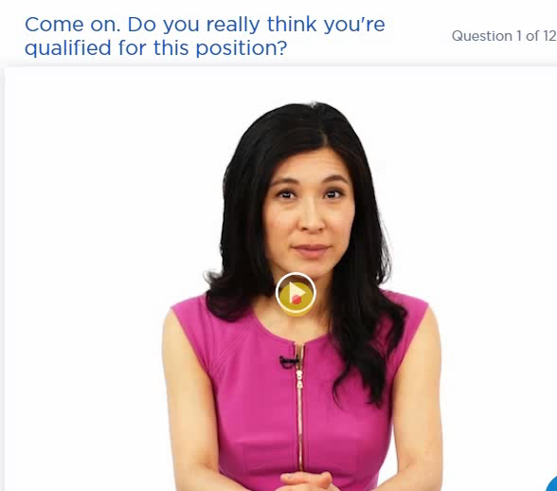
Taking this aggressive tone may be an attempt to see how you respond under pressure. Try not to get rattled or intimidated. Focus on the question: She wants to know if you have all of the experience required to succeed in this job.
Your best bet is to stay cool and confidently explain why you think you have what it takes to succeed if hired.
It's very important to come across as confident and enthusiastic here. Make them believe in you -- your abilities and your commitment.
Example Answers:
"I am 100% confident that my experience has prepared me to succeed in this role. I spent three years working as an account manager at an extremely fast-growing start-up. In my first year on the job, I had the opportunity to step up to managing major accounts because we were understaffed. I thrived in my job and was later chosen for a promotion over several more seasoned colleagues. I feel that I've packed a lot of experience into three years and am more than ready to take on my next challenge."

Slide 3
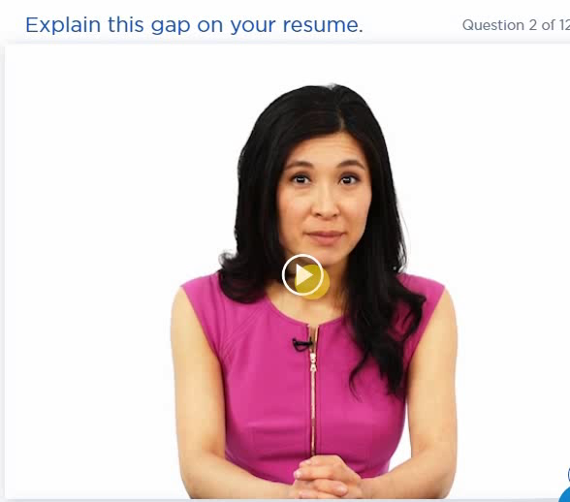
Your interviewer will be reviewing your resume carefully and will notice if you spent some time out of work between positions. This is often a sign that a job didn't end as planned. The abrupt ending may be for reasons unrelated to your work performance (company went out of business, department was eliminated, etc.).
If you have a positive or neutral reason for the gap, go ahead and concisely explain it. If it was a layoff that was unrelated to your performance, make that clear.
Avoid using the word "fired" if you can. Re-direct attention to your track record of jobs that ended well.
If the gap between jobs was lengthy, you should also make it clear that you were keeping busy with classes, volunteer work, or other projects. This shows that you are proactive and energetic.
Example Answers:
"The job wasn't the right fit for me. Looking back, I ignored my instincts and took the position anyway because it was a very generous offer. I won't make the same mistake again. As you can see from my resume, I have been very successful in all of my subsequent positions.“
"They brought in a new manager, who decided to clean house and bring in his own people. I was disappointed because I did a lot of great work for that company and received only high praise from my previous manager. However, in retrospect, it was probably good timing for me to move on to something new."

Slide 4
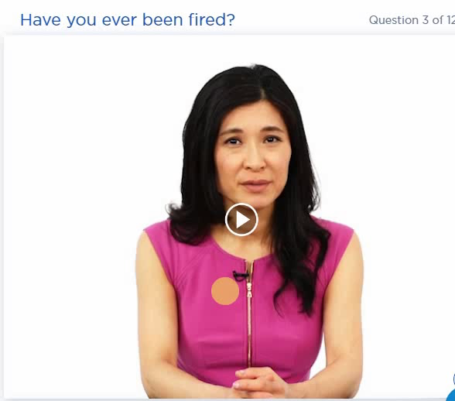
It is very difficult to put a positive spin on getting fired, making this one of the toughest job interview questions to address.
Of course, there's a difference between being terminated because of poor performance and being let go due to downsizing or reorganization.
Avoid using the word "fired" if you can. Draw attention back to your track record of jobs that ended well.
Example Answers:
"The job wasn't the right fit for me. Looking back, I ignored my instincts and took the position anyway because it was a very generous offer. I won't make the same mistake again. As you can see from my resume, I have been very successful in all of my subsequent positions.“
"They brought in a new manager, who decided to clean house and bring in his own people. I was disappointed because I did a lot of great work for that company and received only high praise from my previous manager. However, in retrospect, it was probably good timing for me to move on to something new."

Slide 5
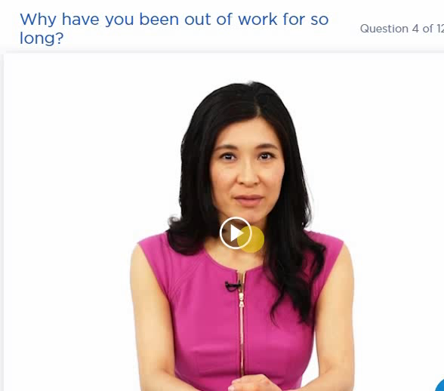
Ouch. This interviewer is cutting right to the chase. In a tough employment market, most interviewers understand that a job search can take time (especially for more senior-level positions).
However, every interviewer still wants to know what you've been doing since you left your last position. An interviewer will be looking for red flags indicating you would be a bad risk as a hire. Is there a troubling reason.
In all cases, it's important to show that you have been staying busy and continuing to develop your skills between full-time jobs (training, consulting, and volunteer work are all excellent ways to do this).
Example Answers:
"The job wasn't the right fit for me. Looking back, I ignored my instincts and took the position anyway because it was a very generous offer. I won't make the same mistake again. As you can see from my resume, I have been very successful in all of my subsequent positions.“
"They brought in a new manager, who decided to clean house and bring in his own people. I was disappointed because I did a lot of great work for that company and received only high praise from my previous manager. However, in retrospect, it was probably good timing for me to move on to something new."

Slide 6
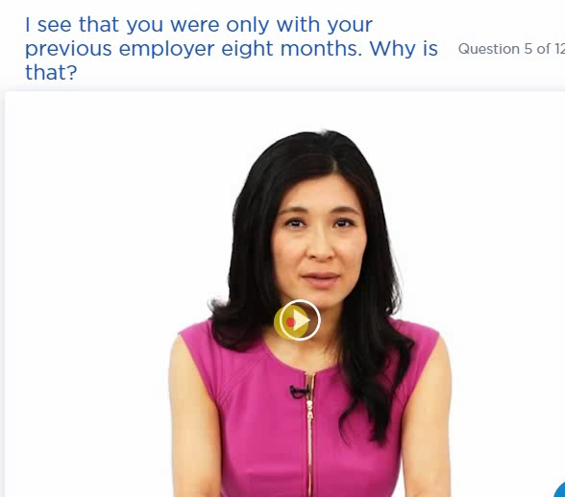
The interviewer wants to make sure that you're not a "job hopper" who will hop away and leave them in a tough spot.
In today's job environment, the definition of "job hopper" has changed. People are less likely to stay in one job for years at a time. From the interviewer's perspective, there are good reasons and bad reasons to leave a position after less than year.
Reason 1 -- The Layoff
Example Answer:
"I outlasted a few rounds of downsizing, but finally got caught up in a department-wide staff reduction. By that point, I was the one in the group with the least seniority. I am proud of what I accomplished in the position, however, and feel ready to apply my skills to a new opportunity."
Reason 2 -- You Moved On
Example Answer:
"After a company reorganization, the role of the department changed and my job duties changed substantially as a result. I was no longer working directly with clients, which is what I love and what is so appealing about the job with your company. Instead, I was spending most of my time in meetings and completing paperwork. When I was offered a position that was a better fit with my strengths, I decided to move on, though I stuck around to help find and train my replacement."
Reason 3 -- You Got Fired
Example Answer:
"The job wasn't the right fit for me. Looking back, I ignored my instincts and took the position anyway because it was a very generous offer. I won't make the same mistake again. As you can see from my resume, I have been very successful in all of my subsequent positions."

Slide 7
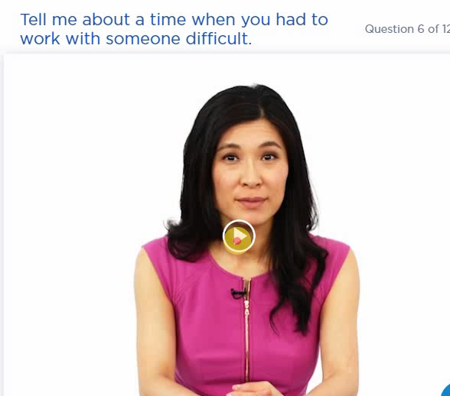
This behavioral interview question is designed to help the interviewer learn more about your ability to handle conflict and work with different personalities.
Behavioral interview questions ask you to detail how you have behaved in a certain situation in the past. Your answers can tell the interviewer a lot about how you might respond in a similar situation while working for them.
Example Answer:
"Last year, I was assigned to take charge of some significant updates to our corporate web site. Part of the project was getting information and approval from the different product teams internally. One of the product experts proved to be challenging to work with. He missed deadlines, didn't show up at meetings, and generally held up the process. He didn't report to me -- in fact, he was senior to me -- so I had to handle it carefully.
I sat down with him explained the importance of the project deadline. I told him that I knew he was incredibly busy and asked him if there was any way that I could help make the process easier for him. It turned out he was stretched way too thin and I suggested he might want to nominate one of his direct reports to represent him at meetings. He loved the idea and the project moved much more quickly after that. In fact, the updated web site helped us improve our online sales by over 35%."

Slide 8
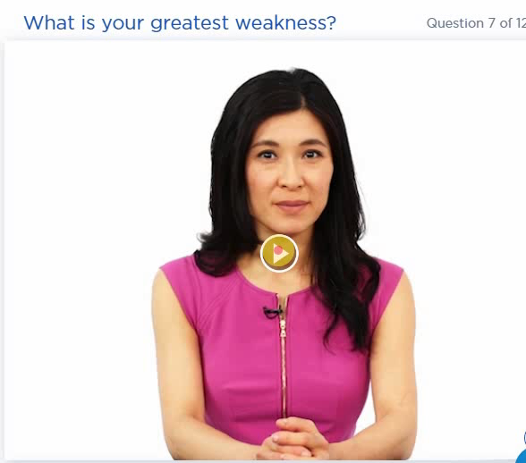
Everybody dreads the "weakness" question and with good reason. There is no perfect answer to this question and it's easy to screw it up. However, with some preparation and practice, you can handle it gracefully and improve your odds of getting hired.
Don't try to play a strength off as a weakness.
Don't choose a weakness that could limit your ability to do the job well.
Don't be defensive or dwell on the negative.
Show that you are aware of the weakness and striving to improve
Example Answer:
"Sometimes I can be a bit too honest when I provide feedback to coworkers. My personality is naturally very straightforward and to the point, and most of my colleagues really value that, but I have learned that there are times on the job when more diplomacy is required. I took a training class on conflict management and it really opened my eyes to the need to communicate differently with different people. So now I am much better at providing constructive feedback, even if it doesn't always come naturally."

Slide 9
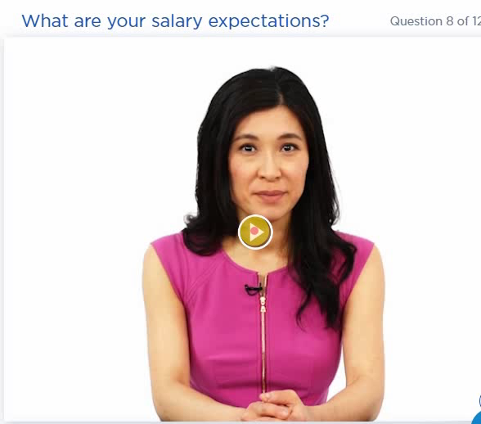
It's the dreaded money question. You want to do whatever you can to keep your options open and get the hiring company to provide a salary range first.
Example Answer:
"I'm very interested in this position, so I would be open to any competitive offer."
"Competitive" means you expect to be compensated fairly and this approach puts the money ball back in the interviewer's court.
They may very well keep pressing you. Follow-up questions could include "What does competitive mean to you?" or "What do you make now?"
If you feel you must name a figure, choose a salary range that provides some negotiation room. Make sure the range is fair based on market value in your industry and city (visit www.salary.com or www.payscale.com for more information about compensation trends). The top of the range should be a number that would make you very happy (within reason).

Slide 10
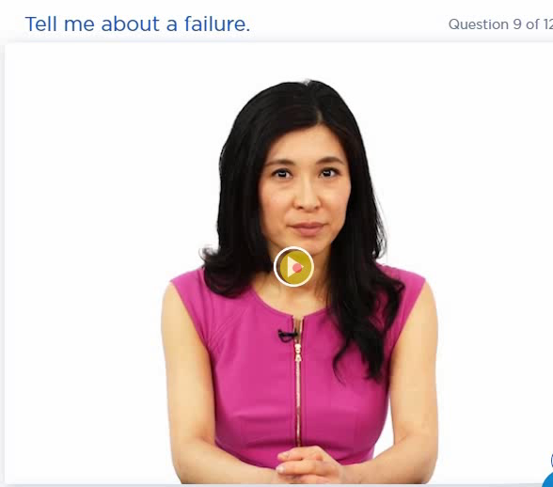
Nobody likes to talk about failures -- especially when you're being judged by a stranger in a job interview with some pretty high stakes.
However, your ability to discuss failure gracefully can go a long way in demonstrating your honesty and ability to learn from your mistakes. This question also helps the interviewer see that you can take calculated risks and learn from them.
The key is to choose a failure that doesn't reveal any serious mistakes or unprofessional behavior that could discredit your qualifications for the job.
Pick a project or initiative that failed due to a combination of factors (not just your actions) and identify something that you learned from the experience. Ideally, your failure story will also showcase some of your positive qualities (initiative, calm under pressure, diplomacy, persistence).

Slide 11

If you're overqualified for the job, the interviewer is going to wonder why you are applying. You probably have a very good reason. Perhaps you're changing industries or it's a tough market and you're trying to get a foot in the door at a good company.
From the employer's perspective, overqualified may be a problem. She may suspect that you're taking whatever you can get right now, but will quit as soon as something a little better comes along.
Example Answer
"I don't see myself as overqualified at all. I think my years of experience will make me a real asset for the department and I'm looking forward to the challenge of working for a company with a broader international presence. At this stage in my career, I'm most interested in finding a position at a company where I can grow -- I'm not concerned about the specific title on my business card."

Slide 12
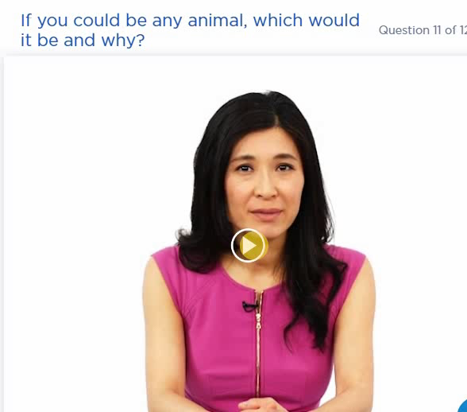
This is a silly question designed to confuse. The idea is to cut through your interview facade and get a sense of the real you -- and how you think when responding spontaneously.
There really is no wrong answer to this question. Pick an animal that represents a positive quality that you possess. Don't be afraid to have a little fun with this question.

Slide 13
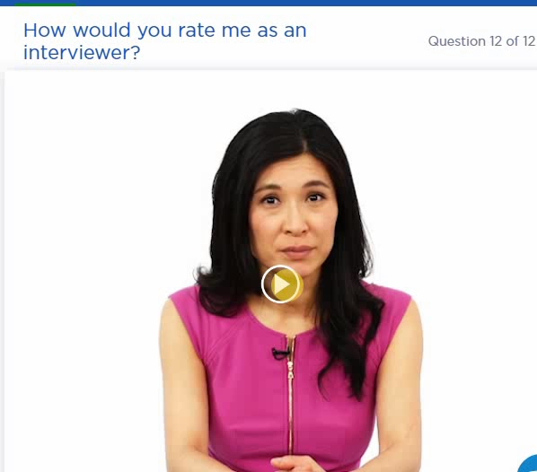
This is definitely a tough question. If the interviewer chooses to ask it, she is unlikely to be satisfied with an answer like, "Just great!" She will probe to ask you why.
If she asks this question, she wants to see how you handle tough questions, testing your critical thinking skills. Provide a positive response and pick an example of a particular question that demonstrated interviewing skills.
Hopefully, I don't have to tell you to avoid giving the interviewer a negative review. The good news here is that a bad or untrained interviewer is unlikely to think to ask this question.
Example Answer:
"I have enjoyed our conversation so far. I can tell that you are a very thorough interviewer and that you're not afraid to ask tough questions. You have asked me a lot of behavioral questions and probed for multiple examples. This tells me that you have very specific criteria."

